Slide 1

VirtuStream Automation
PoC
By Amol Ray
March 09, 2014
GLOBAL SOFTWARE ENGINEERING EXCELLENCE
Version 5.1
Internal Restricted

Slide 2
Agenda
Purpose of Automation
Purpose of Automation PoC
Automation Framework Overview
Folder Structure
Demo
Existing framework vs proposed framework
Q & A

Slide 3
What are the basic expectations from Automation?

Slide 4
Purpose of Automation PoC
All in one automation framework
Efficient way of automating the application
How we can improve the automation quality
Use of Telerik automation Tool.
Reduce the size of code and improve the performance.

Slide 5
Automation Framework Overview
Test Automation Tool & Environment
  Test Studio (Telerik)
  Visual Studio 2010,2012.
Test Environment
  http://www.telerik.com

Slide 6
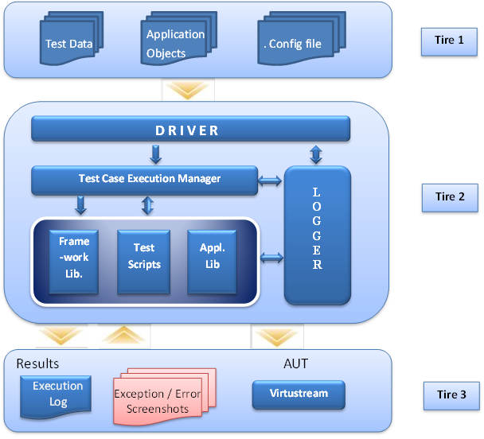
Framework Architecture

Slide 7
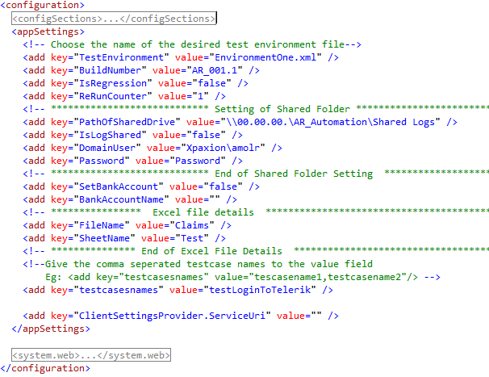
Controller (.Config file)

Slide 8
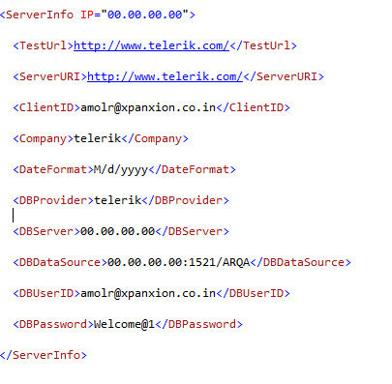
Environment Configuration file

Slide 9
Test Data
Framework provides flexibility to execute different sets of tests.
Test Suites can be created based on
  Workflow
  Execution cycle (regression, Smoke test cases, Sanity test cases, etc.)
Framework uses Data Driven approach, giving flexibility to execute multiple dataset on same test.
Each sheet contains set of related test cases.
Test Data is stored in format of Property – Value pair.
TcID | Tc name

Slide 10
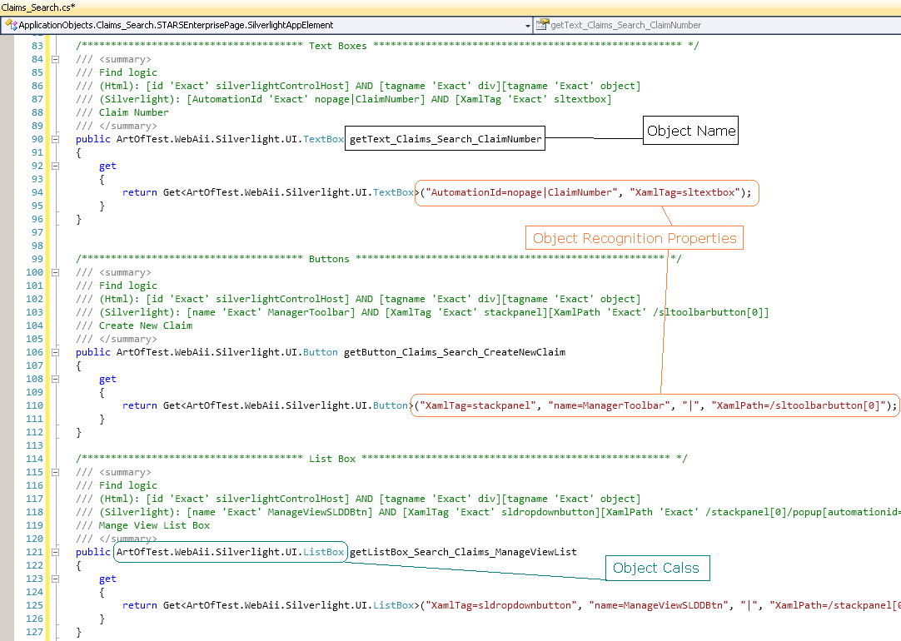
Application Objects

Slide 11
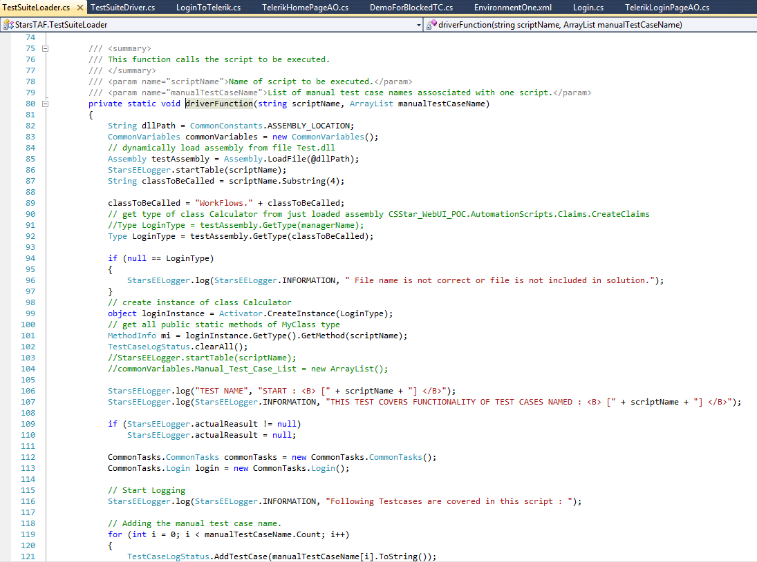
Driver

Slide 12
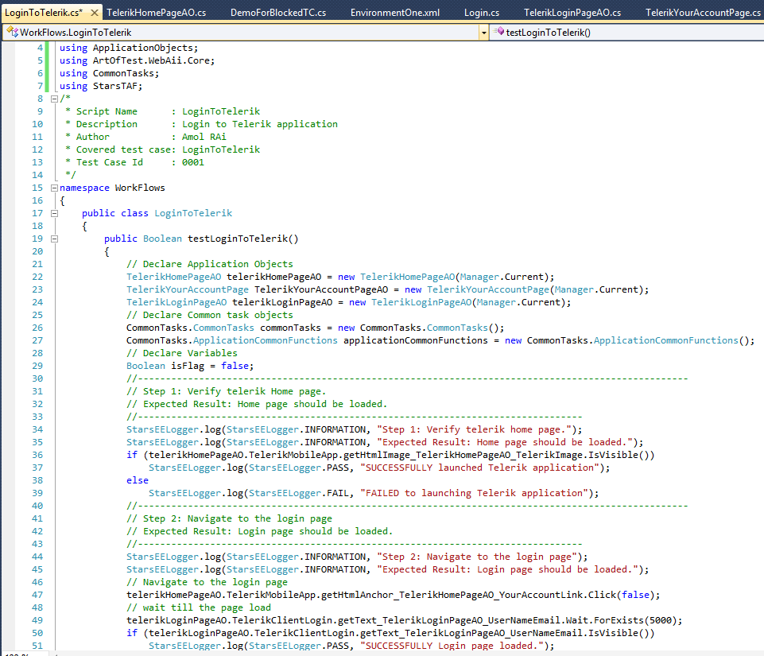
Automation Test Case
User Action

Slide 13
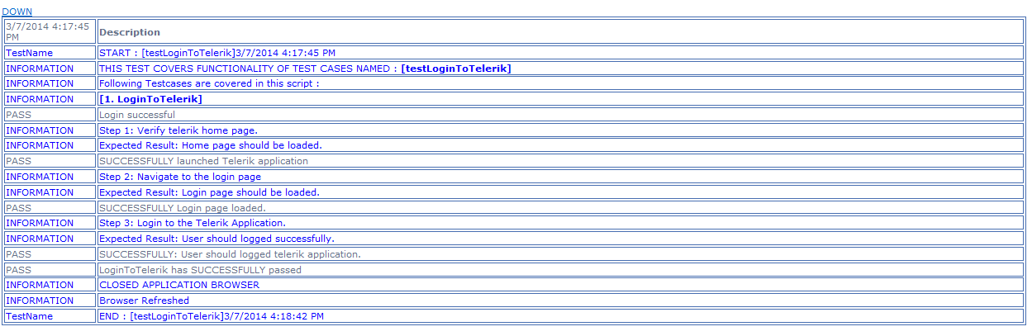
Execution Logs

Slide 14
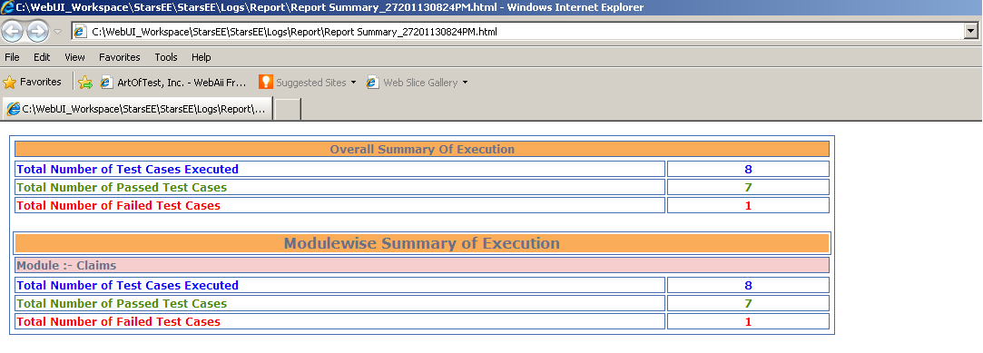
Report Summary

Slide 15
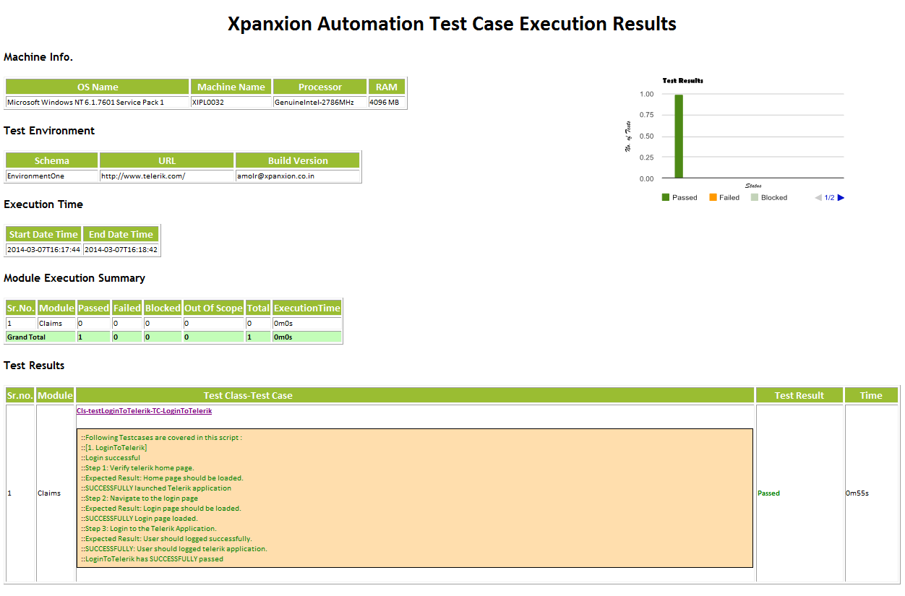
Overall Report Summary

Slide 16
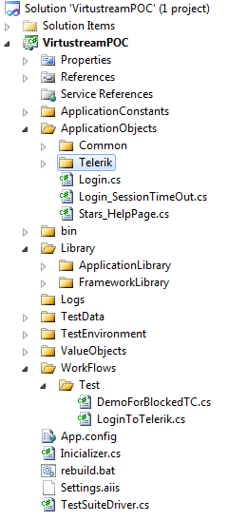
Framework Folder Structure
Application Constants: Used to store configuration settings and global variables
Application Objects: Stores object identification information.
Library: Stores Common functions used across different modules.
Logs: Execution results and stored in logs folder.
Test Data: Stores Controller and Test data sheets.
Test Environment: environment related xml stored in this folder
Value Objects: Objects used for communication across modules.
Workflows: Test scripts created based on test cases
App.Config: Controller file having control which TC has to executed on which environment.
TestSuiteDriver: Main driving engine, reads input and executes maintains execution flow.

Slide 17
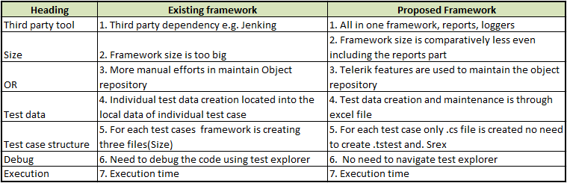
Existing framework vs proposed framework

Slide 18
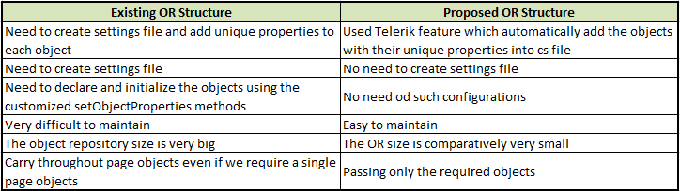
OR structure comparison :

Slide 19
Q & A/Demo

Slide 20
Thank You

